Slide 1
Hypothesis Testing
H0 vs HA

Slide 2
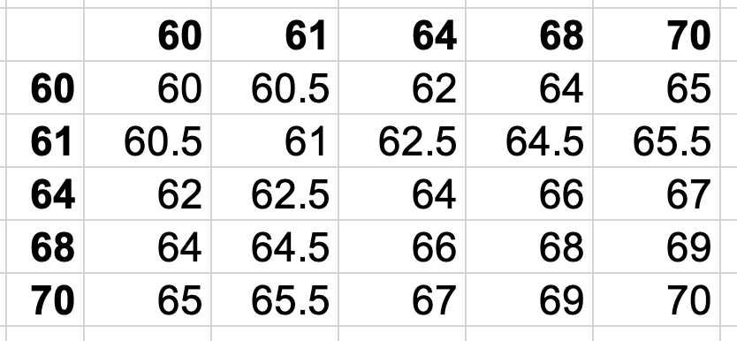
Sampling Distributions
A sampling distribution is a distribution of all of the possible values of a sample statistic for a given sample size selected from a population.
Example:
5 people have the following heights (in inches): 60, 61, 64, 68, 70
The sampling distribution of sample means where n=2 is the

Slide 3
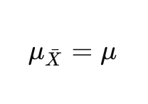
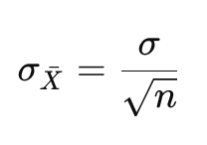
Sampling Distribution Properties
The mean of the sampling distribution is the population mean
The standard deviation of the sampling distribution, also known as the standard error of the mean is the population standard deviation divided by the square root of the sample size

Slide 4
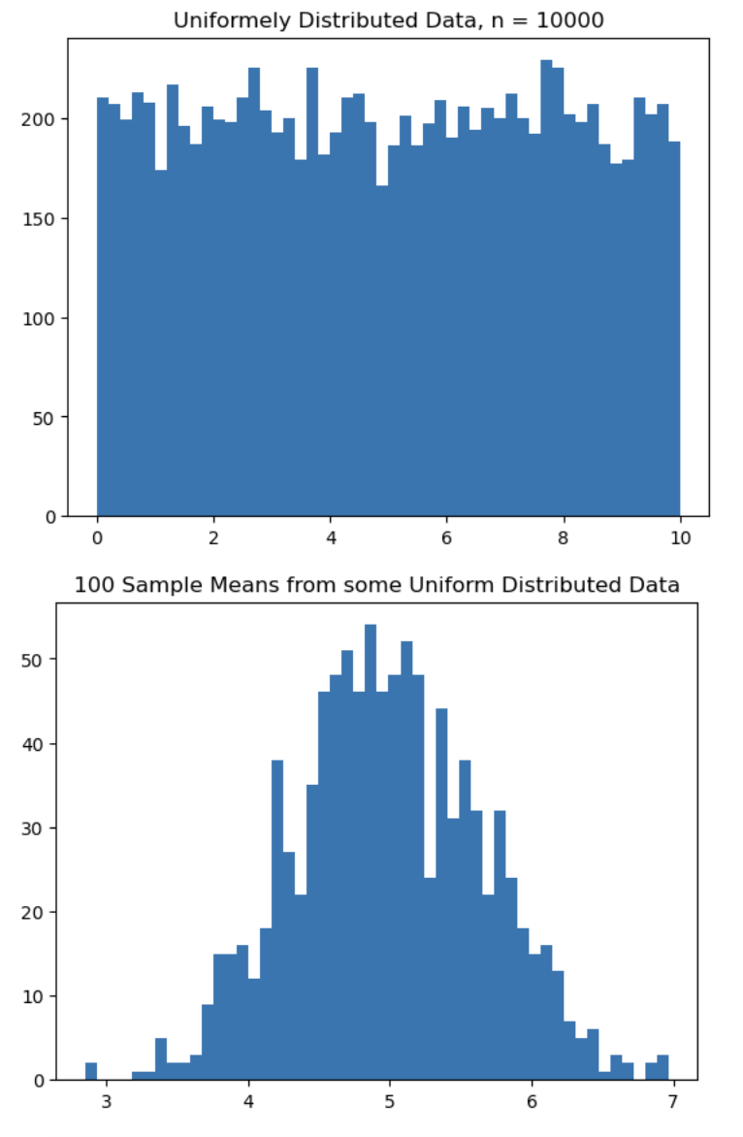
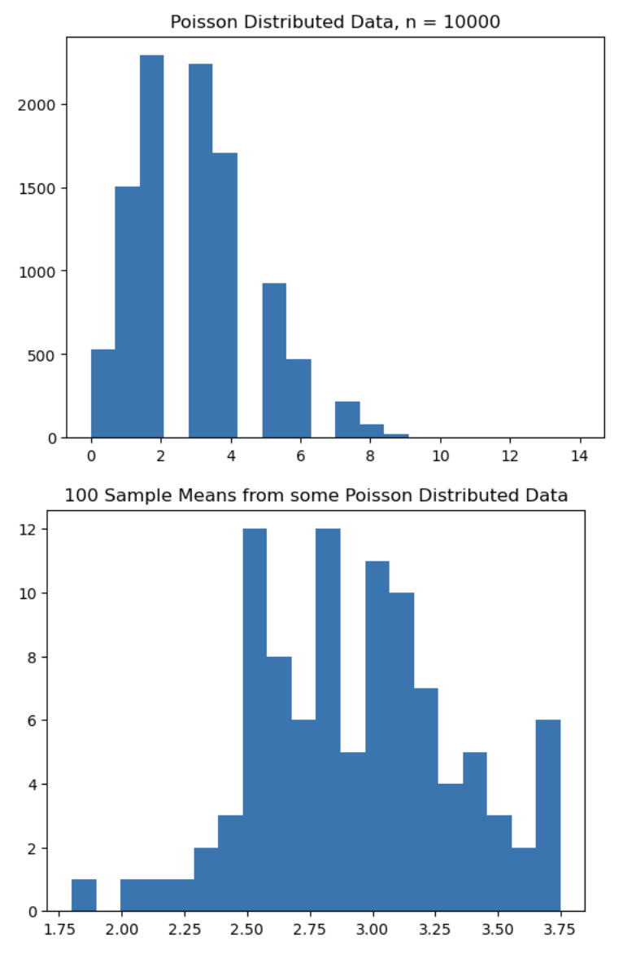
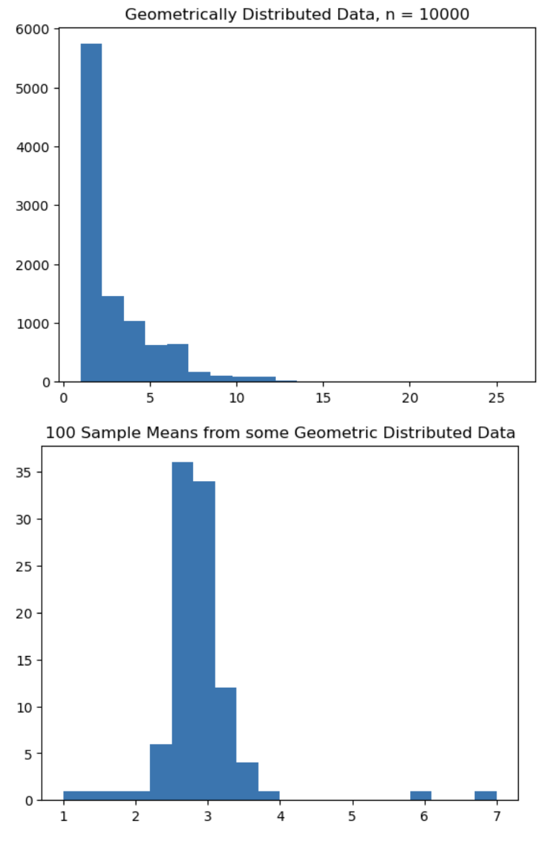
The Central Limit Theorem
Among other things, the Central Limit Theorem (CLT) states that the sampling distribution of sample means will be normally distributed, regardless of the underlying distribution, as long as n >= 30. For mostly symmetrical data, the sampling distribution will be normally distributed if n >= 15

Slide 5
What is Hypothesis Testing?
A method of statistical inference used to decide whether sample data support a particular hypothesis.
Examples:
Does a new drug actually increase typical healing time?
Do new customers actually save a certain amount of money on average?
Is there actually a difference between online and in-person learning outcomes?
Or are observed differences simply due to sampling error*

Slide 6
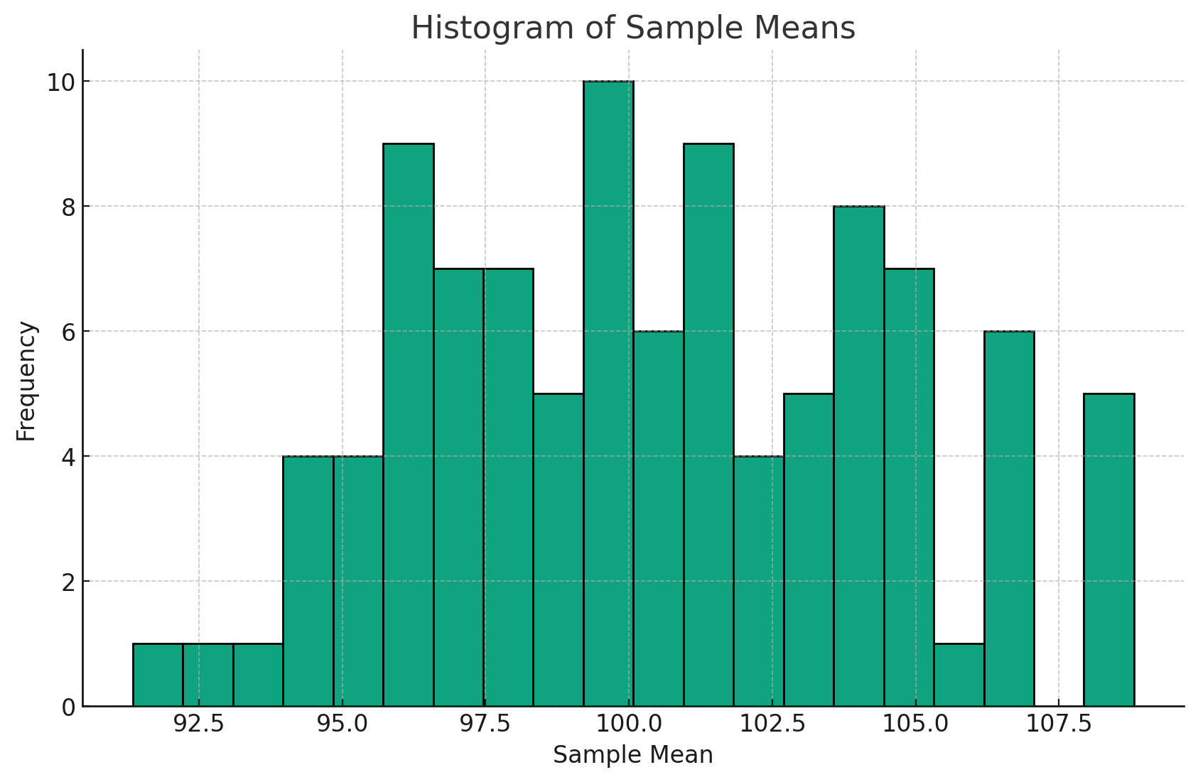
The Logic of Hypothesis Testing
Sampling Error: The difference between a sample statistic and the population parameter from which the sample was drawn.
Researchers need to know if the differences observed exist due to sampling error or because of a real underlying difference
Note: Sampling error does not mean a mistake was made. Sampling error will always occur unless your sample happens to be perfectly representative of your population.
In sampling this data that has a mean of 100, the sample means ranged from 91 to 108

Slide 7
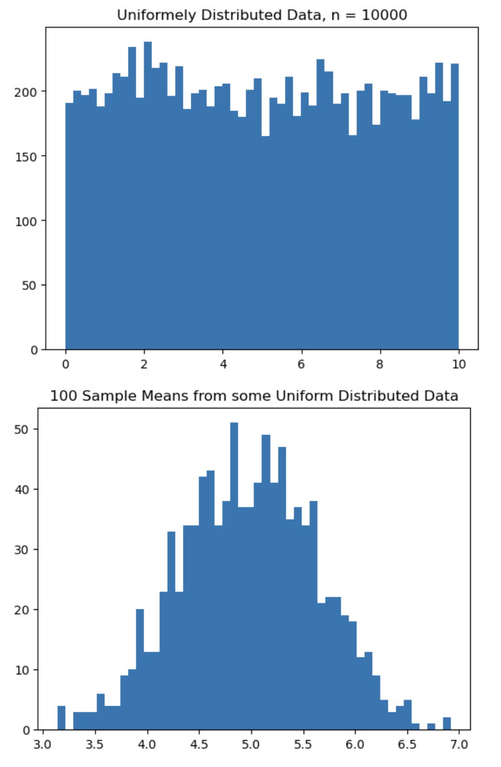
The Logic of Hypothesis Testing
In normally distributed data, values become increasingly rare as they get further away from the mean value.
Since the central limit theorem tells us that distribution of sample means is normally distributed, we can use the normal distribution (or the very similar t-distribution) to tell how likely it is that a given sample mean will occur by chance.
If a value is far enough away from the mean, it is unlikely to be the result of randomness / sampling error and is likely to be a real difference.

Slide 8
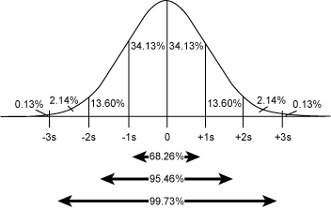
The Empirical Rule (Again)
Extreme values are less likely in data that is normally distributed.
The empirical rule tells us that when data are normally distributed:
68% of the data fall within 1 standard deviation of the mean.
95% of the data fall within 2 standard deviations of the mean
99.7% of the data fall within 3 standard deviations of the mean

Slide 9
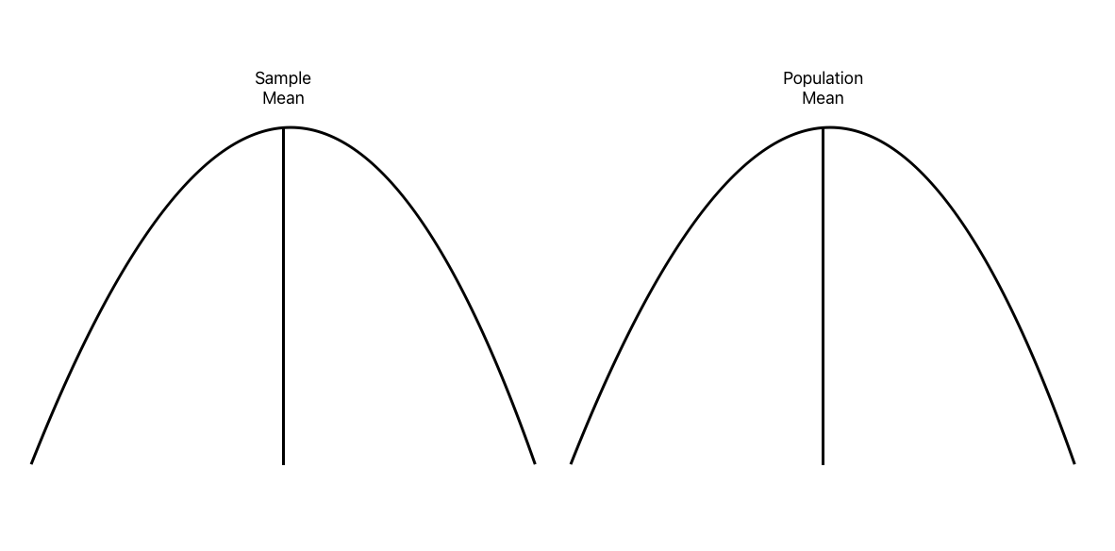
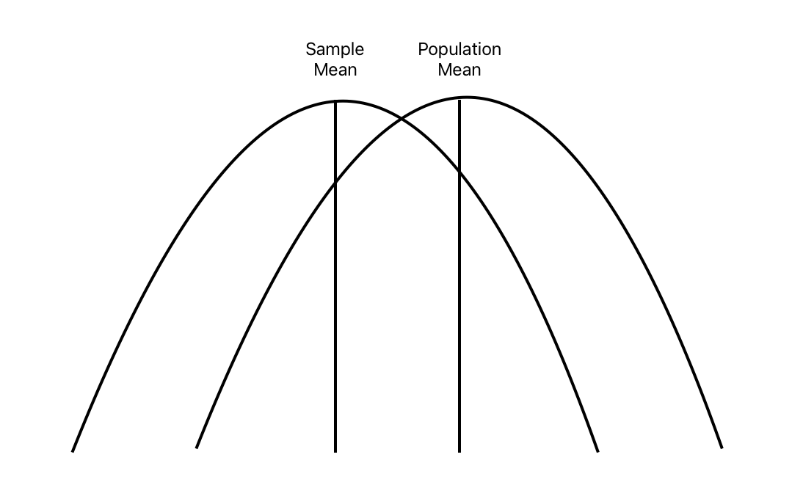
Is the difference due to sampling error or real?
Likely sampling error
Likely a real difference

Slide 10
Assumptions
Several assumptions must be met for hypothesis testing to be valid. For testing differences in means, the following are required:
Data come from a random sample of the population (independent, unrelated, equal probability of getting picked, representative of population)
Data must be normally distributed - CLT has us covered if n>30!
Data must have equal variances - If not, use Welch’s T-Test
Population variance / standard deviation must be known - If not, use T-Test
Sample size should be greater than 30 - If not, use T-Test

Slide 11
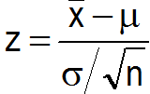
Hypothesis Testing Steps:
State your null and alternative hypotheses.
Determine which type of test to conduct (one vs two sample, one vs two tail, means vs proportions, Z or T).
Determine your decision rule (Z > CV, Z < CV, abs(Z) > abs(CV)).
Select a significance level (alpha) and find the corresponding critical value.
Calculate Z for your data.
Apply the decision rule, draw your conclusion, and live happily ever after!
(Z for single sample hypothesis test)

Slide 12
Step 1: State Your Null and Alternative Hypotheses
Null Hypothesis (HO): What is expected by default / absent any real difference - suggesting that any observed difference is the result of randomness, sampling error, etc, aka the difference is not statistically significant.
Example HO: There is no difference in exam performance between online and in-person students.
Alternative Hypothesis (HA): A statement contradicting the null-hypothesis - suggesting there is a statistically significant difference between groups
Example HA: In-person students score better than / worse than / differently than online students.

Slide 13
Step 2: Determine Which Type of Test to Conduct
Type of Data: Single Sample or Two Sample - Formulas differ!
Type of Statistic / Parameter: Means or Proportions - Formulas differ!
Distribution: Z or T (if sample size is less than 30 or population standard deviation is unknown)
Type of Hypothesis: One-tailed Right (>), One-tailed Left (<), or Two-tailed (=/=) - Decision rules and critical values differ!

Slide 14
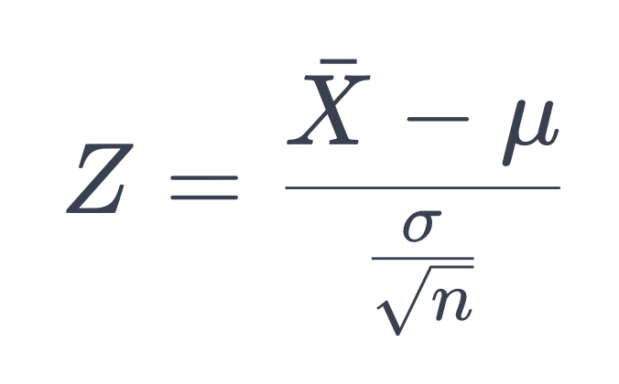
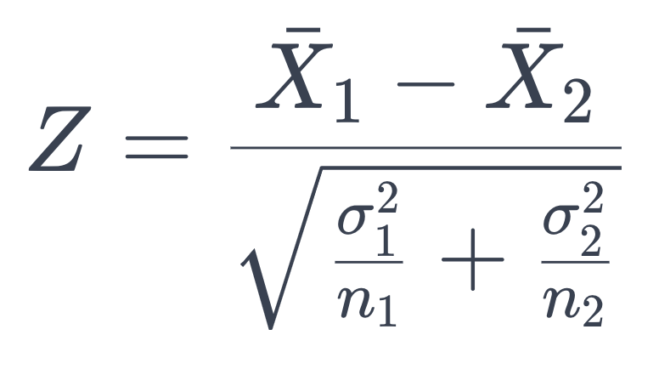
Samples - One or Two Samples?
Single Sample: Sample vs Population
Two Sample**: Sample vs Sample

Slide 15
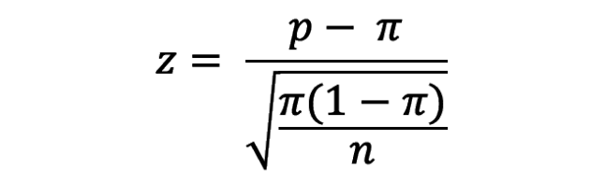
Type of Statistic - Mean or Proportion?

Slide 16
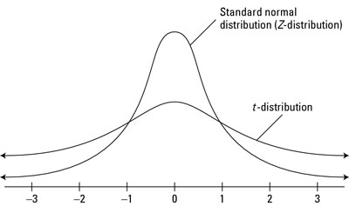
Distribution - Z or T
Is your population standard deviation known?
If so, use Z
Is your population standard deviation unknown, but sample size greater than 30?
If so, use Z
If population standard deviation is unknown and sample size is less than 30, use T

Slide 17
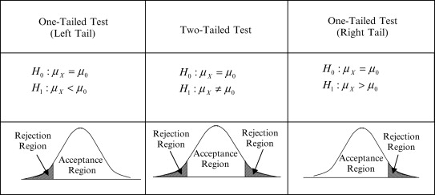
Tails - Left (<), Right (>), or Both (=/=)?
Left tailed tests check to see if a value is less than or equal another value --- HO: Means are equal, HA: Sample mean is less than population mean
Right tailed tests check to see if a value is greater than or equal to another value --- HO: Means are equal, HA: Sample mean is greater than population mean
Two tailed tests check to see if a value is = to another value. HO: Means are equal, HA: there is a statistically significant difference in between the two sets
For 2 tailed tests, alpha is divided by two, so a 95% confidence level means each tail gets (1-95%)/2 = 2.5%

Slide 18
Step 3: Determine Your Decision Rule
Hypothesis | Decision Rule
Sample Value > Population or Other Sample Value | If Z > CV, Reject the Null
Sample Value < Population or Other Sample Value | If Z < CV, Reject the Null
Sample Value =/= Population or Other Sample Value | If Abs(Z) > Abs(CV), Reject the Null

Slide 19
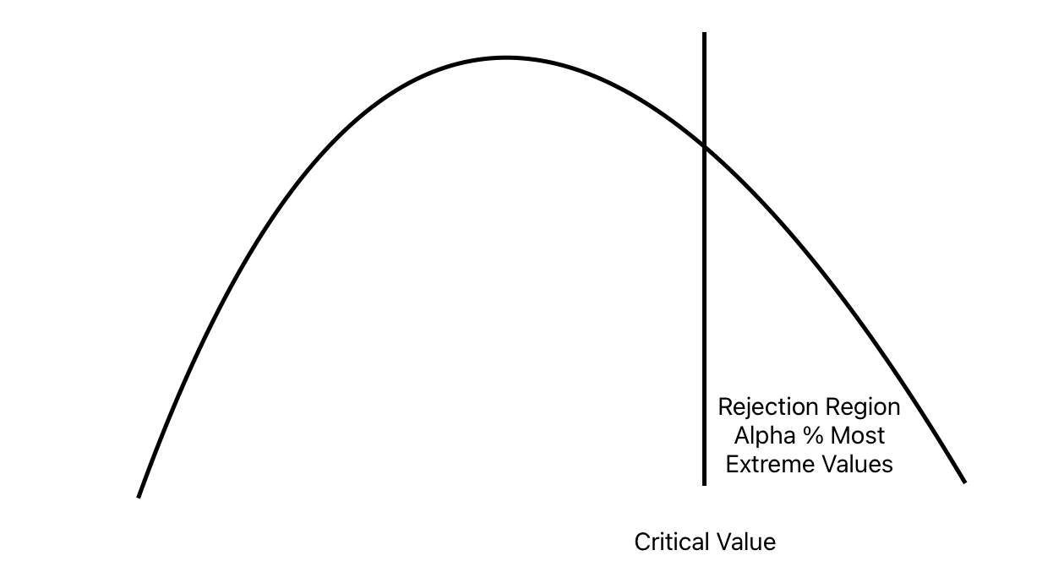

Slide 20
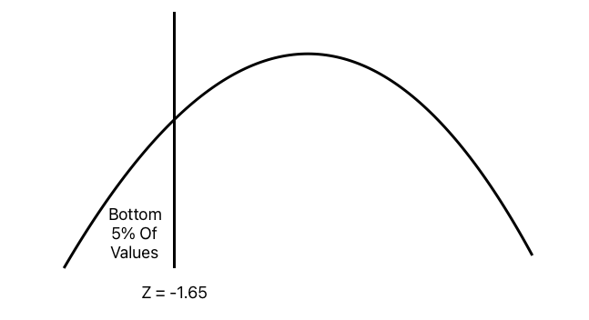
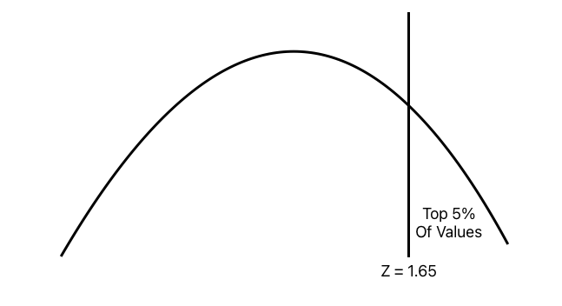
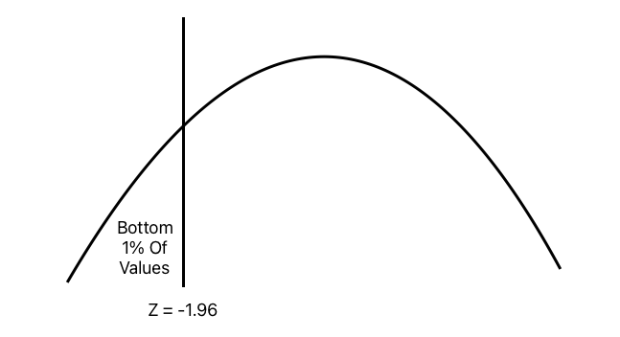


Slide 21
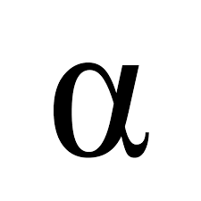
Step 4: Determine Your Significance Level
How willing are you to reject the null hypothesis when it is actually correct?
Type 1 Error: Rejecting the null hypothesis when it is true.
Type 2: Error: Accepting the null hypothesis when it is false
Alpha: The probability that you will commit a type 1 error
Confidence Level: 1 - Alpha

Slide 22
What’s the correct significance level?
There is no such thing!
It depends on:
1) The purpose of your research
2) The seriousness of being wrong
3) The goals of the researcher
4) Other research
5) What’s needed to convince your boss / audience?!

Slide 23
Selecting a confidence level, ex post vs ex ante
Ex post: After the fact
Ex ante: Before the fact
Honest research must select the confidence level ex ante and stay firm!
Otherwise, it’s easy to (difficult not to) select cutoffs based on desired results
Does the vaccine work? Find a “no” at the 5% level, so change it to 10% to get your preferred “yes”

Slide 24
Common Alpha Levels and Critical Values
Alpha | Confidence | Critical Value Z(Alpha) | Critical Value Z(Alpha/2)
10% | 90% | 1.28 | 1.65
5% | 95% | 1.65 | 1.96
1% | 99% | 2.33 | 2.58
Critical values come from Z and T tables.

Slide 25
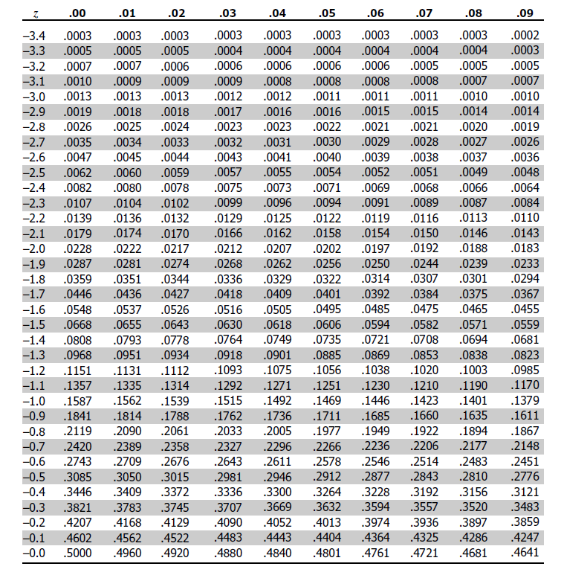
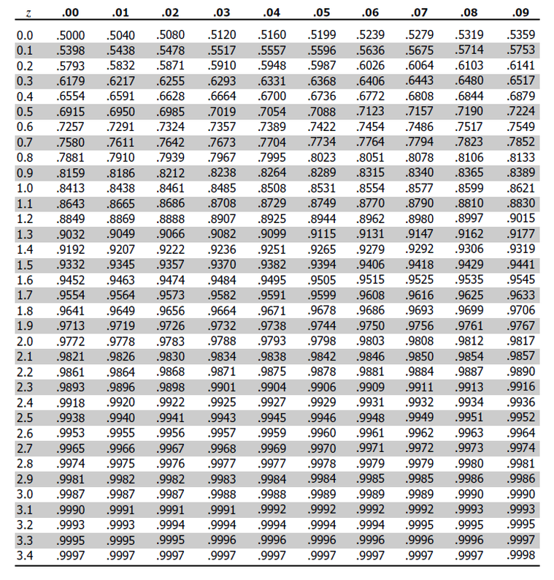
Z Tables (Again)

Slide 26
Step 5: Calculate Z or T for your data

Slide 27
Step 6: Apply your decision rule…
Based on the your test being left, right, or two tailed, compare Z or T to CV
Is the difference in means or proportions large enough that the test statistic exceeds the critical value?

Slide 28
Example Single Sample Hypothesis Test Questions
A new academic “performance enhancing” supplement has made its way into the hands of Professor Wrobel’s statistics class.
The 81 students taking the course all decide to take the supplement and score an average of 76 on the exam.
In the past, students have scored an average of 75, with a standard deviation of 5.
At the 99% confidence level, did the supplement improve the student’s exam scores?
What is the null hypothesis?
What is the alternative hypothesis?
What is alpha?
How many tails?
What is the critical value?
What is Z?
What is the decision rule?
Do you accept or reject the null hypothesis?

Slide 29
One (Right) Tailed Single Sample Means Test
H0: Students taking performance enhancing supplements did the same on the exam as other students have in the past.
HA: Students taking performance enhancing supplements did better on the exam than other students have in the past.
Population Mean Score: 75
Population Standard Deviation: 5
Sample Mean Score: 76
Sample Size: 81
Alpha = 1% (Confidence = 1 - Alpha = 99%)
Decision Rule: If Z > CV, Reject the Null (Since right tailed)
Z = (Sample Mean - Population Mean) / (Population Standard Deviation / Square Root of Sample Size)
Z = (76 - 75) / (5 / 9) = 1.8
Critical Value for Alpha of 1% (from Z Table) = 2.33
Is Z greater than CV? No!
Conclusion: Do not reject the null hypothesis that the supplements did nothing to improve performance at the 99% confidence level.

Slide 30
Example Single Sample Hypothesis Test Questions
The students of Professor Wrobel’s statistics class all decided to get drunk before the exam.
The 36 students taking the course all score an average of 68 on the exam.
In the past, students have scored an average of 75, with a standard deviation of 5.
At the 95% confidence level, did the did drinking before the exam reduce the students’ exam scores?
What is the null hypothesis?
What is the alternative hypothesis?
What is alpha?
How many tails?
What is the critical value?
What is Z?
What is the decision rule?
Do you accept or reject the null hypothesis?

Slide 31
One (Left) Tailed Single Sample Means Test
H0: Students who drank alcohol before the exam did the same on the exam as other students.
HA: Students who drank alcohol on the exam did worse on the exam than other students have in the past.
Population Mean Score: 75
Population Standard Deviation: 5
Sample Mean Score: 68
Sample Size: 36
Alpha = 5% (Confidence = 1 - Alpha = 95%)
Decision Rule: If Z < CV, Reject the Null (Since left tailed)
Z = (Sample Mean - Population Mean) / (Population Standard Deviation / Square Root of Sample Size)
Z = (68 - 75) / (5 / 6) = -8.4
Critical Value for Alpha of 5% (from Z Table) = -1.64
Is Z less than CV? Yes!
Conclusion: Reject the null hypothesis that drinking before the exam had no negative effect on exam scores.

Slide 32
Example Single Sample Hypothesis Test Questions
A new online section of Applied Business Statistics was offered to Webster students this semester. At the end of the course, the online students were still required to take the same in-person exam as conventional students.
The average exam score for the 100 online students was 82, while the average exam score of all past in-person students is 80, with a standard deviation of 6
At the 95% confidence level, was there a meaningful difference, in either direction, between the online students and the conventional students?
What is the null hypothesis?
What is the alternative hypothesis?
What is alpha?
How many tails?
What is the critical value?
What is Z?
What is the decision rule?
Do you accept or reject the null hypothesis?

Slide 33
Two Tailed Single Sample Means Test
H0: Students in a new online section of the class score no differently on the final exam than past students who took the class in person.
HA: Students in the online class score differently (better or worse) on the final exam than past students who took the class in person.
Population Mean: 80
Sample Mean: 82
Population Standard Deviation: 6
Sample Size: 100
Alpha: 5% (Confidence = 1 - Alpha = 95%)
When conducting a two tailed test, use the Z value that corresponds to Alpha / 2
Decision Rule: If Abs(Z) > Abs(CV), Reject the Null
Z = (Sample Mean - Population Mean) / (Population Standard Deviation / Square Root of Sample Size)
Z = (82 - 80) / (6 / 10) = 3.33
Since this is a two tailed test, the critical value comes from the Z Table value for Alpha/2, or 2.5%
Critical Value for Alpha of 2.5% (from Z Table) = 1.96
Is Z greater than CV? Yes!
Conclusion: Reject the null hypothesis that there is no difference in outcomes between online and in-person learning

Slide 34
Example Single Sample Hypothesis Test Questions
The average height of Webster students is thought to be 65 inches, with a standard deviation of 2.5 inches. A sample of 50 students is taken and the average height is 63 inches.
Does the sample support the original data at the 95% confidence level?
What is the null hypothesis?
What is the alternative hypothesis?
What is alpha?
How many tails?
What is the critical value?
What is Z?
What is the decision rule?
Do you accept or reject the null hypothesis?

Slide 35
Proportions

Slide 36
Proportions
Proportion: The percent of the total data that meet a certain criteria
p = x / n
Proportion of people with college degrees = Number of people with a degree / Total number of people
p = Sample proportion
pi = Population proportion
n = Sample size

Slide 37
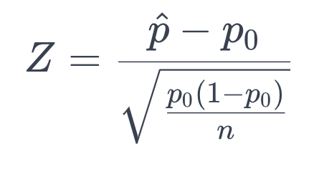
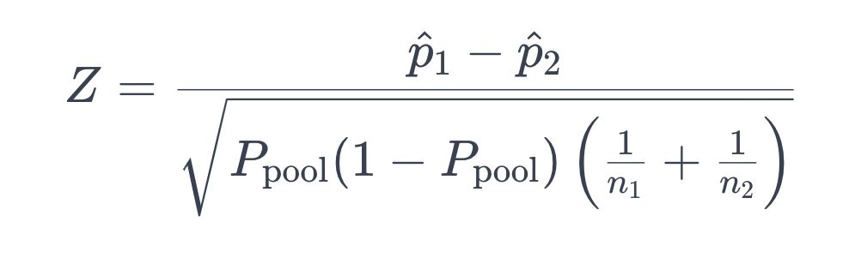
Proportions Tests - One or Two Samples?
Single Proportion: Sample vs Population
Two Proportions: Sample vs Sample

Slide 38
One Tailed (Right) Single Proportion Test
H0: The proportion of students who voted in the last election is equal to the proportion of the general population that voted in the last election.
HA: The proportion of students who voted in the last election is greater than the proportion of the general population that voted in the last election.
Students: 75
Students that voted: 52
Population Proportion (given): 66.8%
Alpha: 5% (Confidence = 1 - Alpha = 95%)
Decision Rule: If Z > CV, Reject the Null
p = 52 / 75 = 0.693
pi = 0.668
CV = 1.65
Z = …math… 0.46
Is Z > CV? No. Do not reject the null hypothesis.

Slide 39
T Testing

Slide 40
Z or T
Use Z if you know the population standard deviation or the sample size is over 30.
If not, use T.
The t-distribution has “fatter tails” that give higher probabilities to extreme values than Z does.

Slide 41
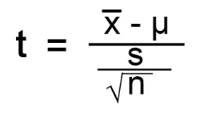
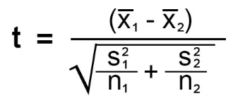
T-Testing
The logic and process of T-Testing is the same as Z testing.
One Sample T-Test
Two Sample T-Test (Unequal Variance)

Slide 42
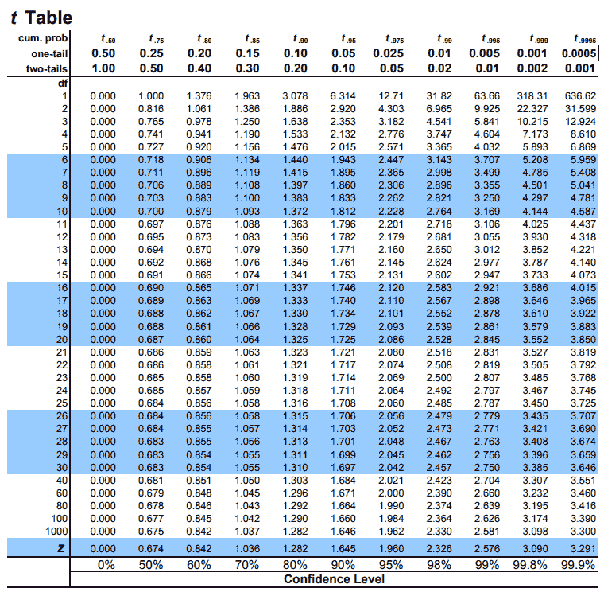
T-Table
Similar to Z-Table, but instead of cumulative probabilities, it’s a table of T-Values
The appropriate values are found by selecting a significance level (alpha) for the appropriate test at the top (1 tail vs 2 tail) and finding its intersection with “degrees of freedom”
Degrees of freedom vary depending on the test being conducted
T-Table is positive values only.
Since the T-Distribution is symmetrical, just multiply the CV by -1 for left tailed tests.

Slide 43
Single Sample T Test - Student’s Test
Same logic as Z test
Use sample standard deviation (s) instead of population standard deviation
Degrees of freedom = n - 1

Slide 44
One (Right) Tailed Single Sample Means Test
H0: Students taking performance enhancing supplements did no better on the exam than other students
HA: Students taking performance enhancing supplements did better on the exam than other students have in the past
Population Mean Score: 75
Sample Mean Score: 76
Sample Standard Deviation: 5
Sample Size: 25
Alpha = 5% (Confidence = 1 - Alpha = 95%)
Decision Rule: If T > CV, Reject the Null
T = (Sample Mean - Population Mean) / (Sample Standard Deviation / Square Root of Sample Size)
T = (76 - 75) / (5 / 5) = 1
DoF = n - 1 = 25 - 1 = 24
CV from T-Table = 1.711
Is T > CV? No.
Conclusion: Do not reject the null hypothesis.

Slide 45
One (Left) Tailed Single Sample Means Test
H0: Students drinking alcohol before the exam did no worse on the exam than other students
HA: Students drinking before the exam did worse on the exam than other students have in the past
Population Mean Score: 75
Sample Mean Score: 70
Sample Standard Deviation: 5
Sample Size: 25
Alpha = 5% (Confidence = 1 - Alpha = 95%)
Decision Rule: If T < CV, Reject the Null
T = (Sample Mean - Population Mean) / (Sample Standard Deviation / Square Root of Sample Size)
T = (70 - 75) / (5 / 5) = -5
CV from T-Table = 1.708 * -1 = -1.708
Is T < CV? Yes.
Conclusion: Reject the null hypothesis.

Slide 46
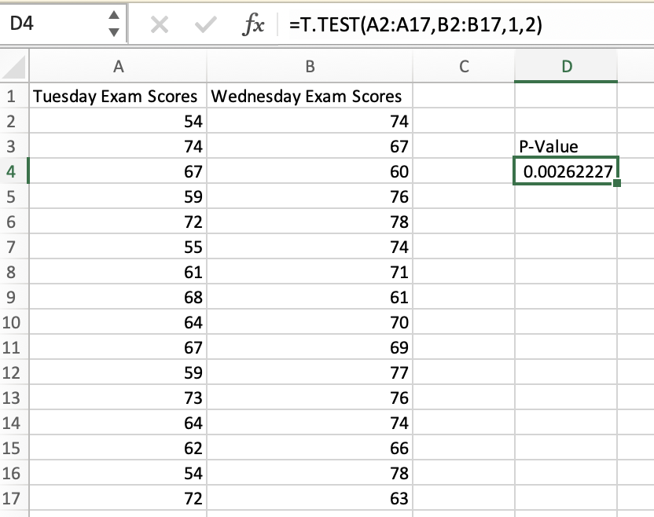
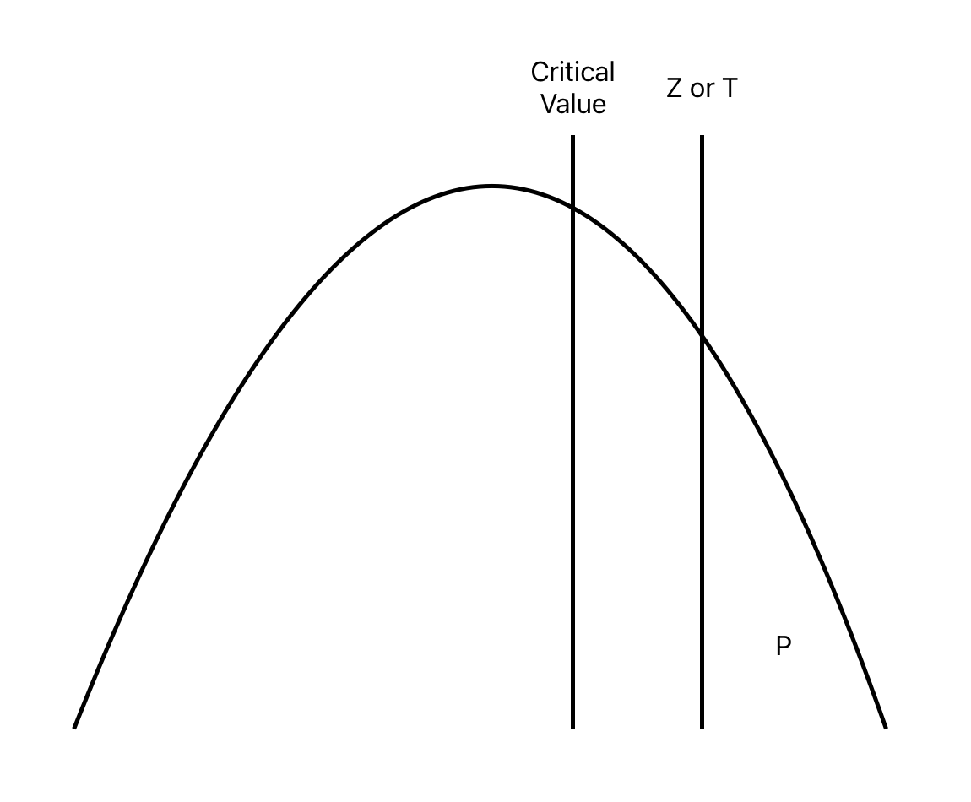
Hypothesis Tests Using P-Values
P-Value: The probability of getting a result as extreme as you’ve got if the null-hypothesis were true.
P is equal to the area under the curve to the outside of the critical value
If your p-value is < alpha, reject the null hypothesis.

Slide 47
Z Test In Excel
Critical Values
=norm.s.inv(alpha) for left tailed test
=norm.s.inv(1-alpha) for right tailed test
=abs(norm.s.inv(alpha/2) for two tailed test
P Values
=1 - norm.s.dist(Z, TRUE) for right tailed test
=norm.s.dist(Z, TRUE) for left tailed test

Slide 48
Z Test In Python
Critical Values
import scipy.stats as stats
stats.norm.ppf(alpha) for a left tailed test
stats.norm.ppf(1-alpha) for a right tailed test
abs(stats.norm.ppf(alpha/2)) for a two tailed test

Slide 49
T Test in Excel
Critical Values
=t.inv(1-alpha,n-1)

Slide 50
T Test in Python
Critical Values
import scipy.stats as stats
stats.t.ppf(1 - alpha, DoF) for one tailed test
stats.t.ppf(1 - (alpha/2), DoF)

Slide 51
Two Sample Testing

Slide 52
Two Sample Z Testing
A two-sample Z test is conducted to assess differences between two populations using samples from each population
Same logic as single sample Z testing
Use when combined sample size is greater than 30 or population variance of each sample is known
Note that population variance is used in this formula, as opposed to standard deviation in the single sample version of the test

Slide 53
Example Two Sample Hypothesis Test Questions
The 40 students of Professor Wrobel’s Wednesday night statistics course scored a mean of 85 on the midterm exam, with a standard deviation of six.
The 35 students in the Tuesday class scored a mean of 80, with a standard deviation of five.
Test the hypothesis that the Wednesday class scored better to a statistically significant extent.
Be 95% confident in your conclusion.
What is the null hypothesis?
What is the alternative hypothesis?
What is alpha?
How many tails?
What is the critical value?
What is Z?
What is the decision rule?
Do you accept or reject the null hypothesis?

Slide 54
One (Right) Tailed Two Sample Means Test w/ Z
H0: Students in the Wednesday class score no better than students in the Tuesday class.
HA: Students in the Wednesday class score better on the exam than students in the Tuesday class.
Tuesday Class Mean: 80
Tuesday Class Size: 35
Tuesday Class Standard Deviation: 5
Wednesday Class Mean: 85
Wednesday Class Size: 40
Wednesday Class Standard Deviation: 6
Alpha: 5% (Confidence = 1 - Alpha = 95%)
Decision Rule: If Z > CV, Reject the Null
Z = (85 - 80) / sqrt(36/40 + 25/35)= 3.93
Critical Value for Alpha of 5% (from Z Table) = 1.65
Is Z greater than CV? Yes!
Conclusion: Reject the null hypothesis that the Wednesday class did no better than the Tuesday class.
It kinda seems like there’s some cheating going on…

Slide 55
Example Two Sample Hypothesis Test Question
The 40 students of Professor Wrobel’s Wednesday night statistics course scored a mean of 85 on the midterm exam, with a standard deviation of six.
The 35 students in the Tuesday class scored a mean of 80, with a standard deviation of five.
Test the hypothesis that the Wednesday class scored differently, but not in either direction (better/worse) to a statistically significant extent.
Be 95% confident in your conclusion.
What is the null hypothesis?
What is the alternative hypothesis?
What is alpha?
How many tails?
What is the critical value?
What is Z?
What is the decision rule?
Do you accept or reject the null hypothesis?

Slide 56
One (Right) Tailed Two Sample Means Test w/ Z
H0: Students in the Wednesday class score no differently than students in the Tuesday class.
HA: Students in the Wednesday class score differently on the exam than students in the Tuesday class.
Tuesday Class Mean: 80
Tuesday Class Size: 35
Tuesday Class Standard Deviation: 5
Wednesday Class Mean: 85
Wednesday Class Size: 40
Wednesday Class Standard Deviation: 6
Alpha / 2: 2.5% (Confidence = 1 - Alpha = 95%)
Decision Rule: If Z > CV, Reject the Null
Z = (85 - 80) / sqrt(36/40 + 25/35)= 3.93
Critical Value for Alpha of 5% (from Z Table) = 1.96
Is Z greater than CV? Yes!
Conclusion: Reject the null hypothesis that the Wednesday class did no better than the Tuesday class.
It kinda seems like there’s some cheating going on…

Slide 57
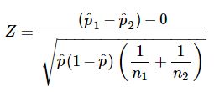
Two Tailed Two Proportions Test w/ Z
HO: There is no difference in the proportion of students who get fail the online section of this course and the in-person section of this course
HA: There is a statistically significant difference in the proportion of students who fail in the online section of this course and the in-person section of this course.
In-person students (n1): 75
In-person fails: 15
Online students (n2): 90
Online fails: 10
Alpha = 5%
Alpha / 2 = 2.5% (since two tailed)
Decision Rule: Abs(Z) > Abs(CV) = Reject Null
P1 = 15 / 75= 0.2
P2 = 10 / 90 = 0.11
P = (15 + 10) / (75 + 90) = 25 / 165 = 0.15
1 - P = 0.85
…math…
Z = 1.59
CV = 1.96 (From a Z Table)
1.59 < 1.96 = Do Not Reject Null

Slide 58
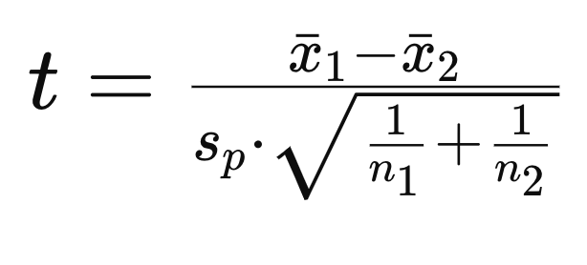
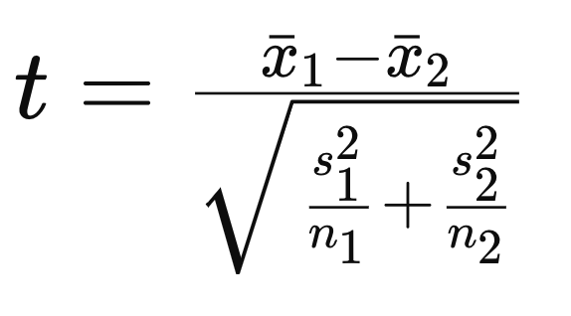
Two Sample T Testing
A two-sample T test is conducted to assess differences between two populations using samples from each population
Same logic as single sample Z testing
Use when combined sample size is less than 30 or population variance of each sample is unknown
Formulas vary based on samples having equal variance or not.
Note that sample variance is used in this formula, as opposed to standard deviation in the single sample version of the test

Slide 59
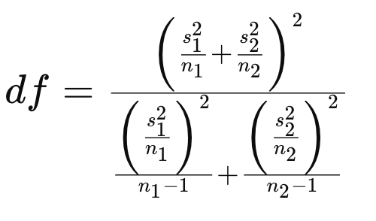
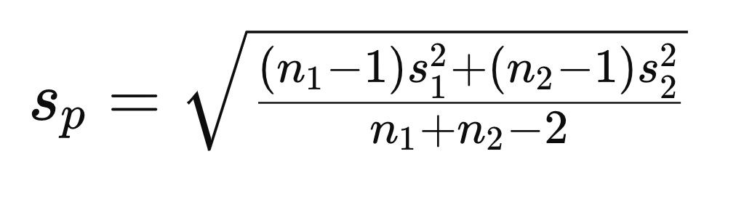
Two Sample T Testing - Are Variances Equal?
Equal Variances
Unequal Variances

Slide 60
T-Table Again
Similar to Z-Table, but instead of cumulative probabilities, it’s a table of T-Values
The appropriate values are found by selecting a significance level (alpha) for the appropriate test at the top (1 tail vs 2 tail) and finding its intersection with “degrees of freedom”
Degrees of freedom vary depending on the test being conducted
T-Table is positive values only.
Since the T-Distribution is symmetrical, just multiply the CV by -1 for left tailed tests.

Slide 61
Two Sample T-Test - Equal Variances - Student’s Test
If variances are (roughly) equal*, use the formulas to the right to conduct “Student’s T-Test”
Critical values are found in a T-Table or software
Sp is the pooled standard deviation*
Degrees of freedom are: n1 + n2 - 2

Slide 62
Example Two Sample T-Test Question
The 15 students of Professor Wrobel’s Wednesday night statistics course scored a mean of 88 on the midterm exam, with a standard deviation of 1.7.
The 12 students in the Tuesday class scored a mean of 84.5, with a standard deviation of 1.7.
Test the hypothesis that the Wednesday class scored better to a statistically significant extent.
Be 95% confident in your conclusion.
What is the null hypothesis?
What is the alternative hypothesis?
What is alpha?
How many tails?
What is the critical value?
What is Z?
What is the decision rule?
Do you accept or reject the null hypothesis?

Slide 63
Two Tailed Two Sample T-Test - Equal Variance
HO: There is no significant difference in test scores between the Wednesday and Tuesday classes
HA: The Wednesday class scored significantly higher than the Tuesday class
Wednesday Mean: 88
Wednesday Stdev: 1.7
Wednesday Class Size: 15
Tuesday Mean: 84.5
Tuesday Stdev: 1.7
Tuesday Class Size: 12
Alpha = 0.05
Difference = 88 - 86.5 = 3.5
…math…
T Stat = 5.32
Degrees of freedom = n1 + n2 - 2 = 25
Pooled variance = 1.7
T Critical Value = 2.06
T > CV, reject the null hypothesis

Slide 64
Are variances equal enough?
Rule of 2:
Assuming normally distributed populations…
If
Large Variance / Small Variance)<= 2
variances are considered equal
F Test For Equal Variances
F = Large Variance / Small Variance
Get critical value from F Table
Numerator DoF = n1 -1
Denominator Dof = n2 - 1
If F > CV, reject null hypothesis of equal variances

Slide 65
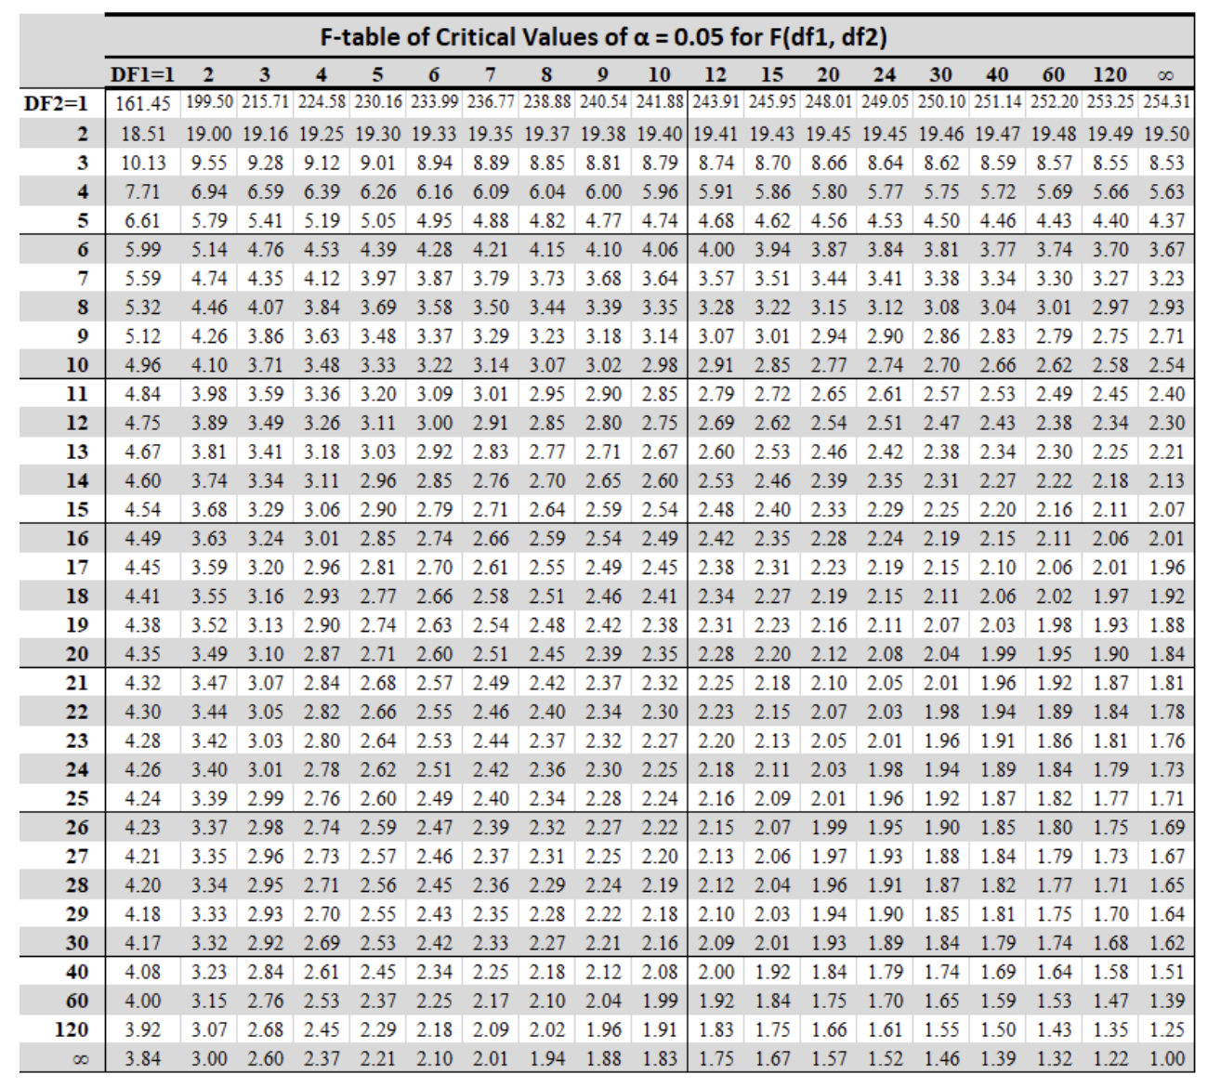
F Test for Equal Variance
Let’s use the last example, but make the second standard deviation equal to 1.8
Monday variance = 2.89, n =15
Tuesday variance = 3.24, n = 11
F = 1.12
CV = F(n=10,d=14) = 2.6

Slide 66
Two Sample T-Test - Unequal Variances - Welch’s Test
If variances are unequal, use the formulas to the right to conduct “Welch’s T-Test”
Critical values are found in a T-Table or software
Degrees of freedom are found using the second formula…
If variances are equal and sample size is the same, degrees of freedom is n1 + n2 - 2

Slide 67
Example Two Sample T-Test Question
The 15 students of Professor Wrobel’s Wednesday night statistics course scored a mean of 88 on the midterm exam, with a standard deviation of 1.7.
The 12 students in the Tuesday class scored a mean of 86.5, with a standard deviation of 1.9.
Test the hypothesis that the Wednesday class scored better to a statistically significant extent.
Be 95% confident in your conclusion.
What is the null hypothesis?
What is the alternative hypothesis?
What is alpha?
How many tails?
What is the critical value?
What is Z?
What is the decision rule?
Do you accept or reject the null hypothesis?

Slide 68
Two Tailed Two Sample T-Test - Unequal Variance
HO: There is no significant difference in test scores between the Wednesday and Tuesday classes
HA: The Wednesday class scored significantly higher than the Tuesday class
Wednesday Mean: 88
Wednesday Stdev: 1.7
Wednesday Class Size: 15
Tuesday Mean: 86.5
Tuesday Stdev: 1.9
Tuesday Class Size: 12
Alpha = 0.01
Difference = 88 - 86.5 = 1.5
…math…
T Stat = 2.13
Degrees of freedom = 22
T Critical Value = 2.82
T < CV, do not reject the null hypothesis

Slide 69
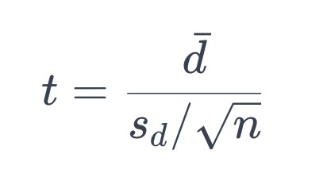
Paired T Testing
If the elements sampled are the same between samples, such as in a before vs. after comparison, use a Paired T Test.
d-bar = the average of all the differences between the two samples
sd = the standard deviation of the differences between the two samples
The rest of the process is same as in the other tests
Degrees of freedom = n - 1, where n = number of pairs of data

Slide 70
Paired T Testing
Before | After | Difference
225 | 237 | -12
191 | 184 | 7
270 | 261 | 9
181 | 179 | 2
225 | 221 | 4
301 | 288 | 13
240 | 221 | 19
253 | 248 | 5
366 | 332 | 34
205 | 195 | 10
253 | 274 | -21
Mean Difference = 6.36
Standard Deviation of Differences = 14.49
sqrt(11) = 3.32
t = 1.45
n = 11 pairs
Alpha = .05
DoF = 10
CV = 1.812

Slide 71
How to decide what test to use: # of Tails and # of Samples
Types of Hypothesis Test
One Sample:
Testing sample statistic vs population parameter
Two Sample:
Testing two sample statistics against each other
One Tail:
Statistic is greater or less than parameter
Two Tail:
Statistic is not equal (could be greater or less to parameter
One Tail: Statistic from one sample is greater or less than statistic from other sample
Two Tail:
Statistic from one sample is equal or not equal to statistic from another sample

Slide 72
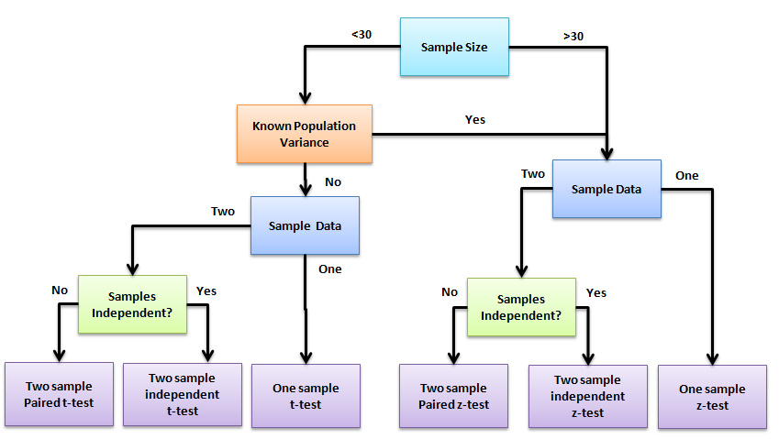
Which Test is Best?

Slide 73
Hypothesis Tests Using P-Values
P-Value: The probability of getting a result as extreme as you’ve got if the null-hypothesis were true.
P is equal to the area under the curve to the outside of the critical value
If your p-value is < alpha, reject the null hypothesis.

Slide 74
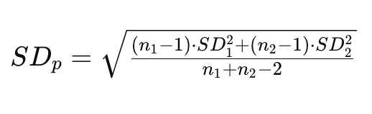
Significance vs Magnitude
An effect can be statistically significant but tiny
Maybe I’m 99% confident that I run 1/1,000th faster than my friend
Use Cohen’s D to compute size of effect
Gives us the number of standard deviations between two sample means
D = (Xbar1 - Xbar2) / SDp
SDp = Pooled standard deviation
D = 0.2 | Small effect
D = 0.5 | Medium effect
D = 0.8 | Large effect

